Slide 1

Distributional Impacts of Energy and Climate Policies in Germany and the EU
Montenegro
Roland

Slide 2
Agenda
Introduction
Environmental tax reform (ETR)
Methodological implementations
Household consumption
Elasticity of substitution between energy and housing services
Scenarios
Limitations and Results

Slide 3
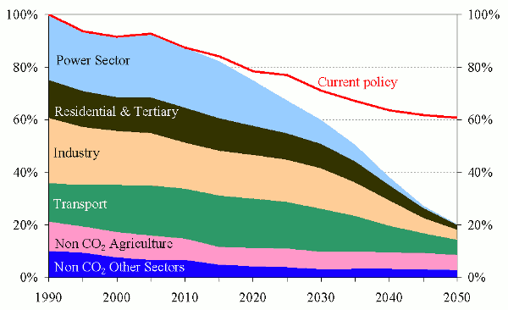
Introduction
European Emission target
The burden has to be distributed among all the sectors in the economy.
Source: EC
https://ec.europa.eu/clima/policies/strategies/2050_en

Slide 4
Introduction
Distributional impacts
What are they?
Distributional impacts refer to the case when different household groups or individuals are affected by a policy to a different degree.
Commonly associated with inequality
Differences in environmental burden
Distribution of income
Distribution of welfare
Access to energy (and carbon)

Slide 5
Introduction
Distributional impacts
Yellow vest movement
2030 Agenda for Sustainable Development by the United Nations

Slide 6
Recap from last year
Motivation – Households
Household 1
Household 2
Household 3
Household 4
Household 5
Income
€
€
€
€
Population
€
€
€
€
€
€
€
€
€
€

Slide 7
Recap from last year
Motivation – Challenge

Slide 8
Recap from last year
Motivation – Challenge

Slide 9
Scenarios
Reduction scenario

Slide 10
Scenarios
Revenue recycling scenarios
No revenue recycling – Status Quo
Per capita redistribution
Labor tax
Value added tax (VAT)

Slide 11
Recap from last year
Motivation – Challenge

Slide 12
Recap from last year
Motivation – Summary
Assessment of climate polices is measured not only on how much climate impact they avoid, but also on their impact in the whole economy
What are the costs to the households?
How the costs of climate policies vary between different households?
And the what are costs to production sectors?

Slide 13
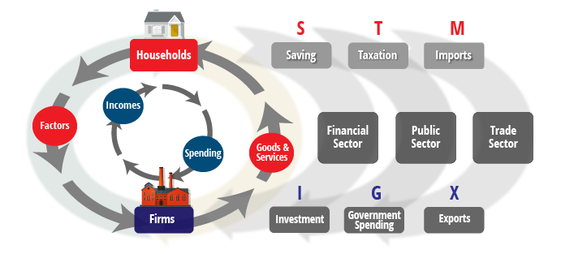
Recap from last year
Motivation – Why NEWAGE?

Slide 14




Recap from last year
NEWAGE
Computable General Equilibrium Model
Based on Walras’ theory of general equilibrium, which was latter formalized by Arrow and Debrew
In CGE models, in opposition to linear and non-linear models where there is one objective function, every agent tries to maximize its own objective function
Producers maximize
Profit
Consumers maximize
Utility

Slide 15
Recap from last year
Motivation – Why NEWAGE?
Armington Aggregation
Consumption
Representative Agent
Trade and distribution of goods to different sectors
Goods
Utility
Tax
CO2
Households and Government
Investments
Tax
Tax
Investments
Goods
Transport
Production
Taxes
Production
Sectorial production and fossil fuels
Capital, Labor, Resources, CO2
Energy Production
Power generation
Tax
Tax

Slide 16
Recap from last year
NEWAGE
Armington Aggregation
Consumption
Representative Agent
Trade and distribution of goods to different sectors
Goods
Utility
Households and Government
Tax
CO2
Investments
Tax
Tax
Investments
Goods
Transport
Production
Taxes
Production
Sectorial production and fossil fuels
Capital, Labor, Resources, CO2
Energy Production
Power generation
Tax
Tax

Slide 17
Recap from last year
Modelling different households
Government
Representative Agent
Household 1
Households and Government
Disaggregation
Household 2
Household 3
Household 4
Household 5

Slide 18

Recap from last year
Modelling different households
Three steps:
Modelling the consumption
Composition of Skilled and Unskilled labor
Composition of Capital endowment
From the consumption levels it is possible to define the income quintiles.
Following, it is possible to find the share that each household reserves for each sector
Use data from EUROSTAT’s budget surveys. Already have access!
Done in cooperation with LEI, partner form REEEM

Slide 19
Recap from last year
Modelling different households
Three steps:
Modelling the consumption
Composition of Skilled and Unskilled labor
Composition of Capital endowment
Representative Agent
Capital
Households and Government
Skilled
Unskilled
Labor

Slide 20
Recap from last year
Modelling different households
Three steps:
Modelling the consumption
Composition of Skilled and Unskilled labor
Composition of Capital endowment
Representative Agent
Labor
Capital
Investments
Capital
Households and Government
Labor

Slide 21
Modelling different households
Modelling different households - Consumption
No. | Sector
1 | Coal
2 | Natural gas
3 | Crude oil
4 | Petroleum
5 | Electricity
6 | Iron & Steel
7 | Non-ferrous metals
8 | Non-metallic minerals
9 | Paper, pulp & print
10 | Chemicals
11 | Food & Tobacco
12 | Motor vehicles
13 | Machinery
14 | Rest of industry
15 | Buildings
16 | Transport
17 | Agriculture
18 | Services
GOODS
Representative Agent
Households and Government
Consumption
Utility

Slide 22
Modelling different households
Challenges of disaggregation: Heterogeneous consumption patterns
Disaggregation
Former RA‘s boundary
Consumption Gov
Utility Gov
Government
Consumption HH5
Utility hh5
Household 5
Consumption
Utility hh4
Household 4
Consumption HH4
Consumption HH3
Utility hh3
Household 3
Consumption HH2
Utility hh2
Household 2
Consumption HH1
Utility hh1
Household 1

Slide 23
Findings and Challenges
Modelling different households
No. | Sector
1 | Coal
2 | Natural gas
3 | Crude oil
4 | Petroleum
5 | Electricity
6 | Iron & Steel
7 | Non-ferrous metals
8 | Non-metallic minerals
9 | Paper, pulp & print
10 | Chemicals
11 | Food & Tobacco
12 | Motor vehicles
13 | Machinery
14 | Rest of industry
15 | Buildings
16 | Transport
17 | Agriculture
18 | Services
Representative Agent
Capital
Households and Government
Labor

Slide 24
Modelling different households
Challenges of disaggregation: hidden tax transfer
Representative Agent
Households and Government
Taxes
Capital
Labor
Utility
Resources

Slide 25
Modelling different households
Challenges of disaggregation: hidden tax transfer
Representative Agent
Households
Households
Households
Households
Households
Taxes
Capital
Taxes
Labor
Government
Utility
Resources

Slide 26
Findings and Challenges
Challenges of disaggregation: hidden tax transfer
Representative Agent
Households
Households
Households
Households
Households
Government to Person
Social Benefits
Income tax refunds
Pension and Social security
...
Person to Government
Income Tax
Social security and pension
Government services
...
Taxes
Government
Notes:
https://siteresources.worldbank.org/FINANCIALSECTOR/Resources/General_Guidelines_Govt_Payment_Aug2012.pdf

Slide 27
Modelling different households
Challenges of disaggregation: hidden tax transfer
Former RA‘s boundary
Government to Person
Household 5
Household 4
Taxes
Government
Household 3
Household 2
Household 1
Person to Government

Slide 28


Findings and Challenges
Heterogeneous Labor, Capital, Taxes Return and Savings
Income
Household 1
Population
Household budget
survey
Household 2
Harmonization
Household 3
Household 4
Household 5

Slide 29
Preliminary results
Results from projects – Consumption EU28 - 2011
 | hh1 | hh2 | hh3 | hh4 | hh5 | hh1/hh5
Coal | 0.08% | 0.08% | 0.06% | 0.05% | 0.03% | 2.92
Agriculture | 2.42% | 2.03% | 1.77% | 1.57% | 1.18% | 2.06
Food and Tobacco | 17.27% | 15.05% | 13.45% | 12.04% | 9.25% | 1.87
Electricity | 3.91% | 3.41% | 3.04% | 2.63% | 2.15% | 1.82
Gas | 0.67% | 0.67% | 0.63% | 0.55% | 0.40% | 1.66
Energy (Aggregated) | 7.66% | 7.59% | 7.53% | 7.22% | 6.26% | 1.23
Services | 51.91% | 52.81% | 52.28% | 52.11% | 52.10% | 1.00
Chemicals | 3.09% | 3.27% | 3.45% | 3.47% | 3.25% | 0.95
Non-ferrous metals | 0.01% | 0.01% | 0.01% | 0.02% | 0.01% | 0.95
Transportation | 4.32% | 4.05% | 3.82% | 4.21% | 4.78% | 0.90
Paper, pulp & print | 1.47% | 1.69% | 1.75% | 1.77% | 1.77% | 0.83
Oil Products | 3.00% | 3.43% | 3.79% | 3.99% | 3.67% | 0.82
Non-metallic minerals | 0.35% | 0.39% | 0.44% | 0.47% | 0.45% | 0.79
Rest of industry | 6.69% | 7.01% | 7.76% | 8.24% | 8.70% | 0.77
Building | 0.86% | 0.86% | 1.05% | 1.06% | 1.20% | 0.71
Machinery | 1.88% | 2.50% | 3.11% | 3.64% | 4.90% | 0.38
Vehicles | 2.06% | 2.73% | 3.58% | 4.18% | 6.14% | 0.34

Slide 30
Preliminary results
Results from Disaggregation – Income EU28 in 2011

Slide 31
Recap from last year
NEWAGE
Armington Aggregation
Consumption
Representative Agent
Trade and distribution of goods to different sectors
Goods
Utility
Households and Government
Tax
CO2
Investments
Tax
Tax
Investments
Goods
Transport
Production
Taxes
Production
Sectorial production and fossil fuels
Capital, Labor, Resources, CO2
Energy Production
Power generation
Tax
Tax

Slide 32
Preliminary results
Actual Stage of NEWAGE
Taxes’ Revenue
CO₂ Certificates
Tax
Government Consumption
Government
Armington Aggregation
Utility
Trade and distribution of goods to different sectors
Goods
Consumption
G2P
Consumption
Consumption
Consumption
Household Consumption
P2G
Tax
Utility
Tax
Households
Households
Goods
Investments
Households
Tax
Households
Investments
Households
Transport
Production
Capital, Labor
Resources, CO₂
Production
Sectorial production and fossil fuels
Energy Production
Power generation
Tax
Tax

Slide 33
Preliminary results
Actual Stage of NEWAGE
Technology description in NEWAGE cannot be as detailed as in TIMES-PanEU.
Calibrate NEWAGE‘s Reference Scenario according to values from TIMES-PanEU
Technology development of production sectors
Upper and Lower growth boundaries for electricity generation
TIMES-PanEU
Reference Values
NEWAGE

Slide 34
Preliminary results
Scenarios
 | Reference Scenario (REF) | Base Pathway (Base) | Local Solutions (LS) | Paris Agreement – EU (PA_EU) | Paris Agreement (PA)
ETS sectors | 62% reduction in 2050 | 83% reduction in 2050¹ | 83% reduction in 2050¹ | 95% reduction in 2050 compared to 1990 levels | 95% reduction in 2050 compared to 1990 levels
non-ETS sectors | no targets | 50 to 80% reduction in 2050¹ Extra European targets: Industry | 50 to 80% reduction in 2050¹ on the national level Extra European targets: Residential Transport Services
Remaining regions | no targets | see A.2 “Regional Push” | see A.2 “Regional Push” | see A.2 “Regional Push” | In line with the 2°C target
^{[1]} Compared to 2005 levels

Slide 35
Preliminary results
Scenarios

Slide 36
Preliminary results
Results from projects – GDP EU28

Slide 37
Preliminary results
Results from projects – GDP rest of the World (non EU28)

Slide 38
Preliminary results
Results from projects – Efficiency of Carbon cap-and-trade policies

Slide 39
Preliminary results
Results from projects – Consumption of EG

Slide 40
Preliminary results
Results from projects – Efficiency of Carbon cap-and-trade policies

Slide 41
Preliminary results
Results from projects – Income development

Slide 42
Preliminary results
Results from projects – Income development

Slide 43
Bibliography
van Ruijven, Bas J. & O’Neill, Brian C. & Chateau, Jean, 2015. "Methods for including income distribution in global CGE models for long-term climate change research," Energy Economics, Elsevier, vol. 51(C), pages 530-543. https://ideas.repec.org/a/eee/eneeco/v51y2015icp530-543.html
Shoven, J. & Whalley, J., 1992. “Applying General Equilibrium” Cambridge University Press.
A. Bouet, V. Berisha-Krasniqui, C. Estrade und D. Laborde, „Households heterogeneity in a global CGE model: an illustration with the MIRAGE-HH (MIRAGE-HouseHolds) model,“ Larefi, Université Bordeaux 4, Bordeaux, 2013.
W. Cai, Y. Mu, C. Wang und J. Chen, „Distributional employment impacts of renewable and new energy – A case study of china,“ Renewable and Sustainable Energy Reviews, Bd. 39, pp. 1155-1163, 2014.
S. Rausch und M. Mowers, „Distributional and efficiency impacts of clean and renewable energy standards for electricity,“ Resource and Energy Economics, Bd. 36, Nr. 2, p. 556–585, 2014.
Arrow, K. & Debreu, G., 1954. “Existence of Equilibrium for a Competitive Economy” Econometrica, The Econometric Society.
Kelly, D., 2009 “Subsidies to industry and the environment” National Bureau of Economic Research

Slide 44

IER
Roland Cunha Montenegro
roland.montenegro@ier.uni-stuttgart.de
87833
87873
Institut für Energiewirtschaft und Rationelle Energieanwendung (IER)
Heßbrühlstraße 49a, 70565 Stuttgart

Slide 45
Questions?

